Slide 1
Matrices
Introduction

Slide 2
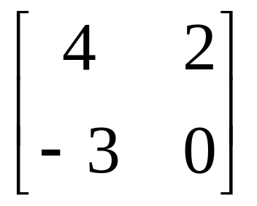
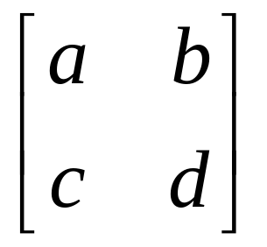
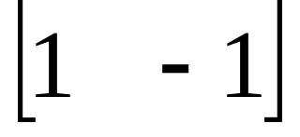
Matrices - Introduction
Matrix algebra has at least two advantages:
Reduces complicated systems of equations to simple expressions
Adaptable to systematic method of mathematical treatment and well suited to computers
Definition:
A matrix is a set or group of numbers arranged in a square or rectangular array enclosed by two brackets

Slide 3
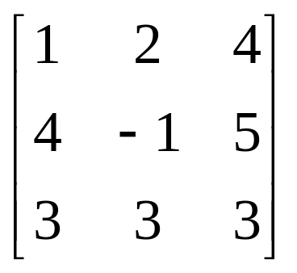
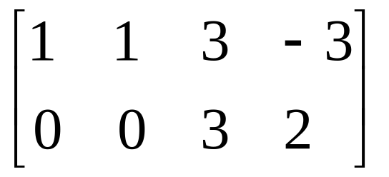
Matrices - Introduction
Properties:
A specified number of rows and a specified number of columns
Two numbers (rows x columns) describe the dimensions or size of the matrix.
Examples:
3x3 matrix
2x4 matrix
1x2 matrix

Slide 4
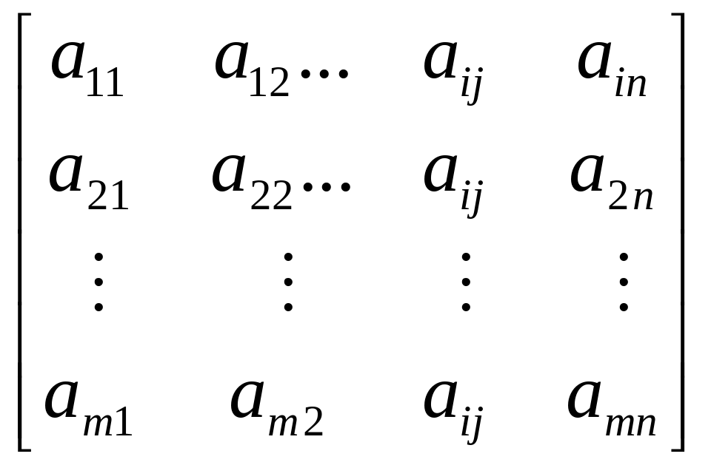
Matrices - Introduction
A matrix is denoted by a bold capital letter and the elements within the matrix are denoted by lower case letters
e.g. matrix [A] with elements a_{ij}
A_{mxn}=
_{m}A^{n}
i goes from 1 to m
j goes from 1 to n

Slide 5

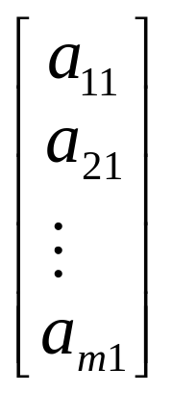
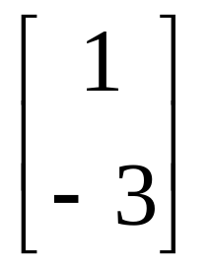
Matrices - Introduction
TYPES OF MATRICES
Column matrix or vector:
The number of rows may be any integer but the number of columns is always 1

Slide 6
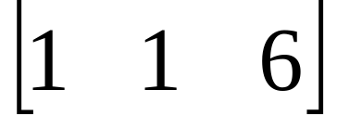

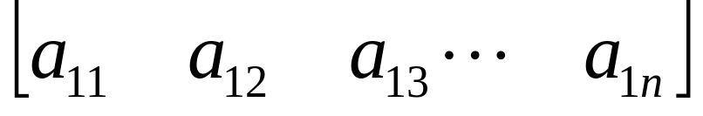
Matrices - Introduction
TYPES OF MATRICES
2. Row matrix or vector
Any number of columns but only one row

Slide 7
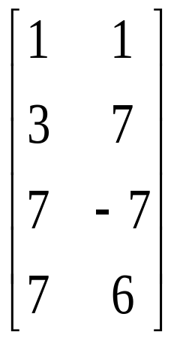
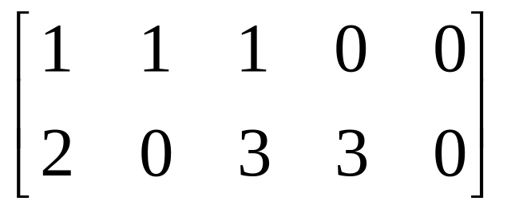

Matrices - Introduction
TYPES OF MATRICES
3. Rectangular matrix
Contains more than one element and number of rows is not equal to the number of columns

Slide 8
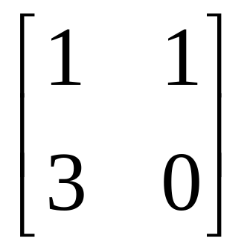
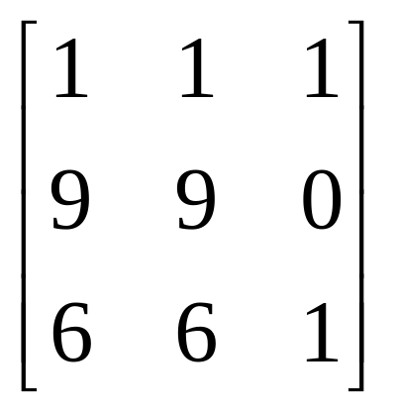
Matrices - Introduction
TYPES OF MATRICES
4. Square matrix
The number of rows is equal to the number of columns
(a square matrix A has an order of m)
m x m
The principal or main diagonal of a square matrix is composed of all elements a_{ij} for which i=j

Slide 9
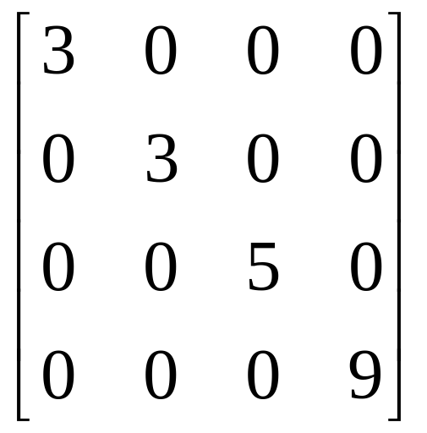
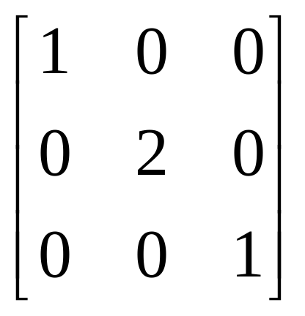
Matrices - Introduction
TYPES OF MATRICES
5. Diagonal matrix
A square matrix where all the elements are zero except those on the main diagonal
i.e. a_{ij} =0 for all i = j
a_{ij} = 0 for some or all i = j

Slide 10
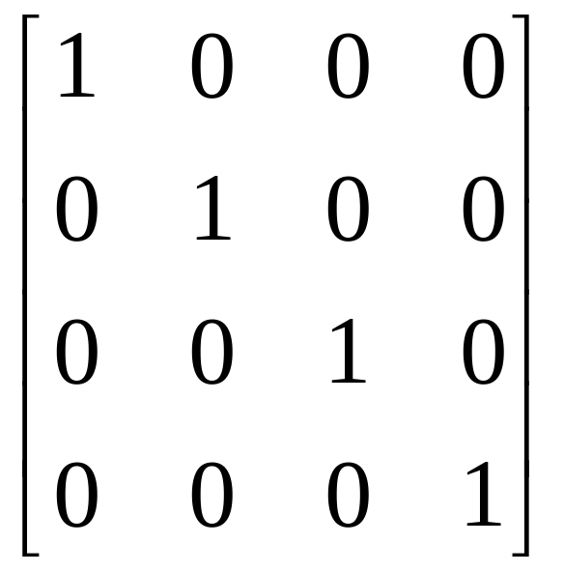
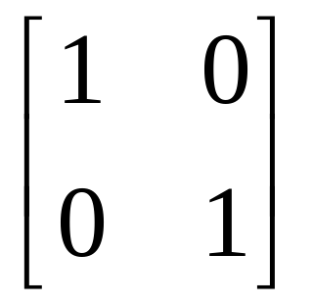
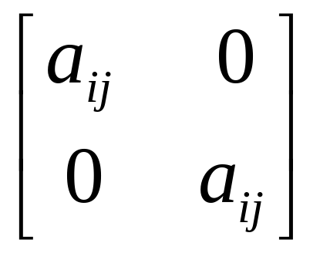
Matrices - Introduction
TYPES OF MATRICES
6. Unit or Identity matrix - I
A diagonal matrix with ones on the main diagonal
i.e. a_{ij} =0 for all i = j
a_{ij} = 1 for some or all i = j

Slide 11
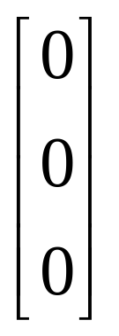
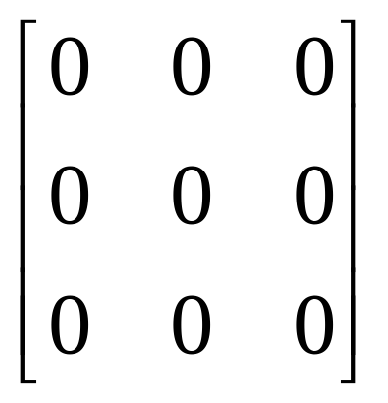
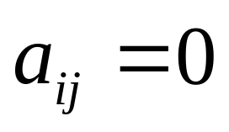
Matrices - Introduction
TYPES OF MATRICES
7. Null (zero) matrix - 0
All elements in the matrix are zero
For all i,j

Slide 12
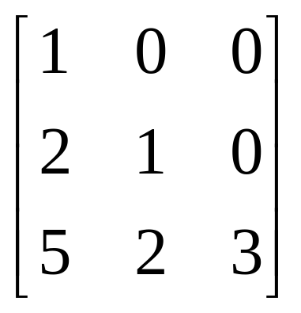
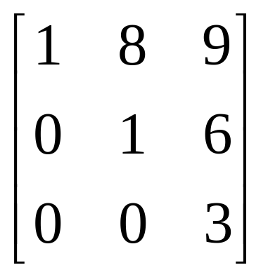
Matrices - Introduction
TYPES OF MATRICES
8. Triangular matrix
A square matrix whose elements above or below the main diagonal are all zero

Slide 13
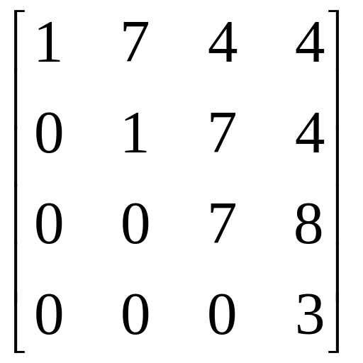
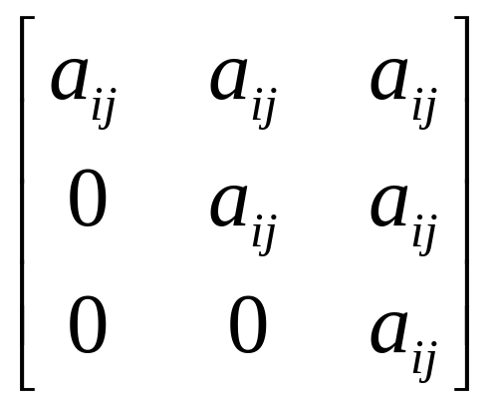
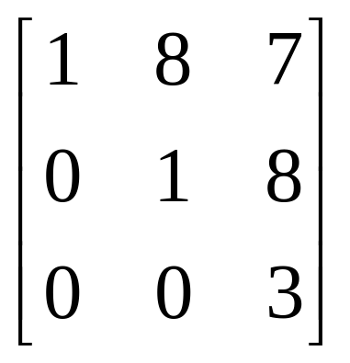
Matrices - Introduction
TYPES OF MATRICES
8a. Upper triangular matrix
A square matrix whose elements below the main diagonal are all zero
i.e. a_{ij} = 0 for all i > j

Slide 14
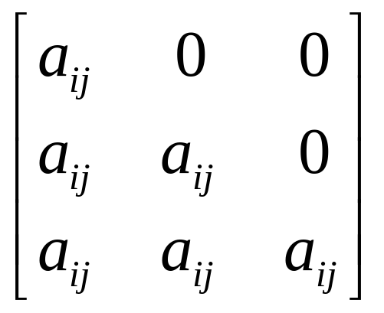
Matrices - Introduction
TYPES OF MATRICES
8b. Lower triangular matrix
A square matrix whose elements above the main diagonal are all zero
i.e. a_{ij} = 0 for all i < j

Slide 15
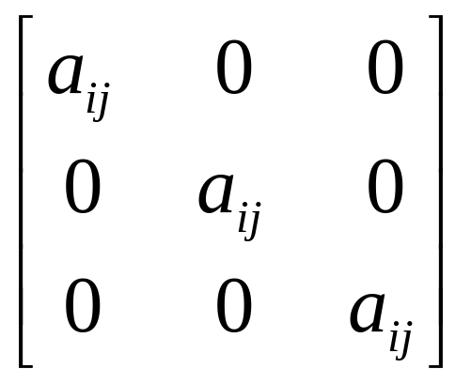
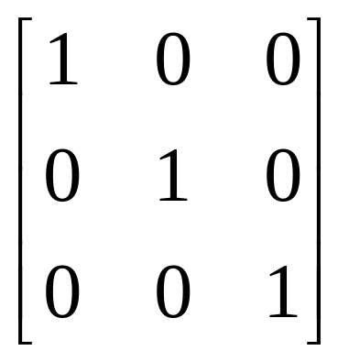
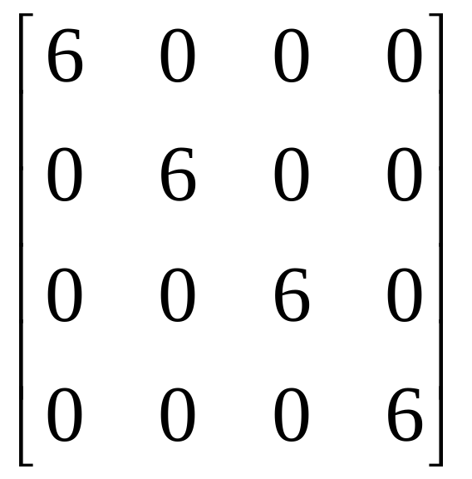
Matrices – Introduction
TYPES OF MATRICES
9. Scalar matrix
A diagonal matrix whose main diagonal elements are equal to the same scalar
A scalar is defined as a single number or constant
i.e. a_{ij} = 0 for all i = j
a_{ij} = a for all i = j

Slide 16
Matrices
Matrix Operations

Slide 17
Matrices - Operations
EQUALITY OF MATRICES
Two matrices are said to be equal only when all corresponding elements are equal
Therefore their size or dimensions are equal as well
A =
B =
A = B

Slide 18
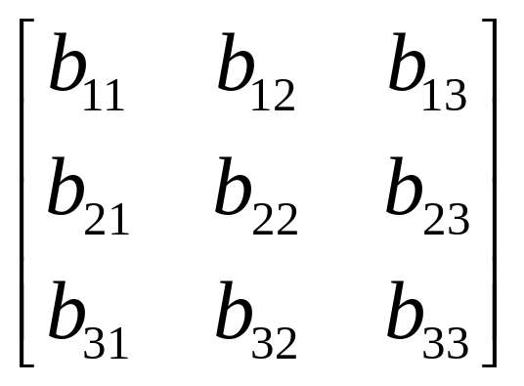
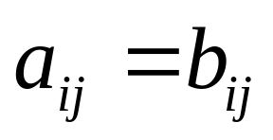
Matrices - Operations
Some properties of equality:
IIf A = B, then B = A for all A and B
IIf A = B, and B = C, then A = C for all A, B and C
A =
B =
If A = B then

Slide 19
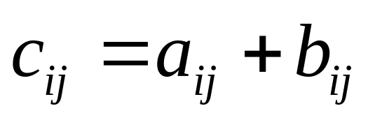
Matrices - Operations
ADDITION AND SUBTRACTION OF MATRICES
The sum or difference of two matrices, A and B of the same size yields a matrix C of the same size
Matrices of different sizes cannot be added or subtracted

Slide 20
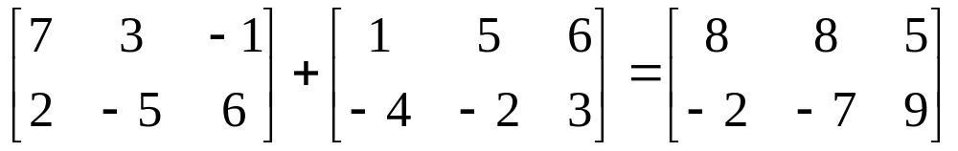
Matrices - Operations
Commutative Law:
A + B = B + A
Associative Law:
A + (B + C) = (A + B) + C = A + B + C
A
2x3
B
2x3
C
2x3

Slide 21
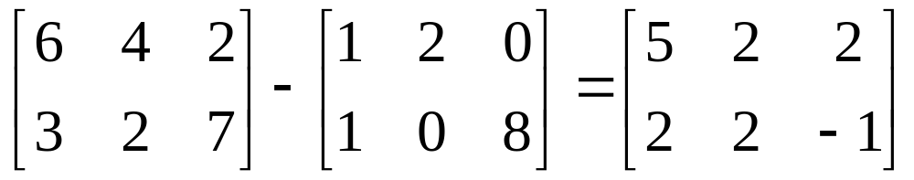
Matrices - Operations
A + 0 = 0 + A = A
A + (-A) = 0 (where –A is the matrix composed of –a_{ij} as elements)

Slide 22
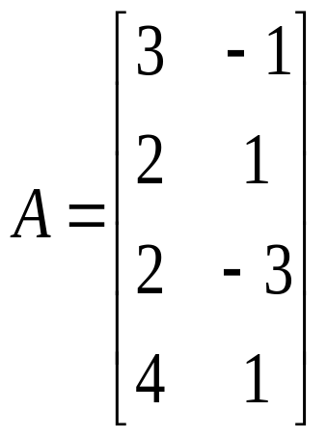
Matrices - Operations
SCALAR MULTIPLICATION OF MATRICES
Matrices can be multiplied by a scalar (constant or single element)
Let k be a scalar quantity; then
kA = Ak
Ex. If k=4 and

Slide 23
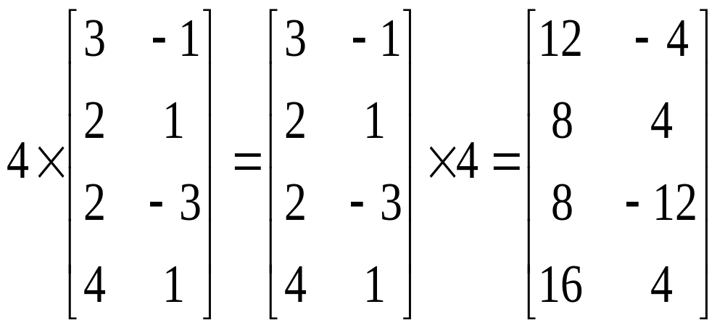
Matrices - Operations
Properties:
k (A + B) = kA + kB
(k + g)A = kA + gA
k(AB) = (kA)B = A(k)B
k(gA) = (kg)A

Slide 24
Matrices - Operations
MULTIPLICATION OF MATRICES
The product of two matrices is another matrix
Two matrices A and B must be conformable for multiplication to be possible
i.e. the number of columns of A must equal the number of rows of B
Example.
A x B = C
(1x3) (3x1) (1x1)

Slide 25
Matrices - Operations
B x A = Not possible!
(2x1) (4x2)
A x B = Not possible!
(6x2) (6x3)
Example
A x B = C
(2x3) (3x2) (2x2)

Slide 26
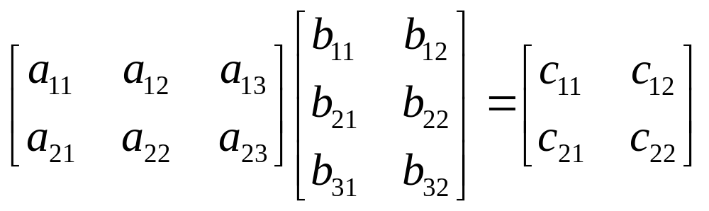
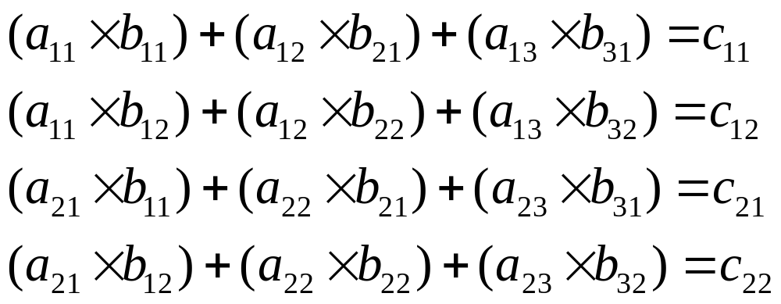
Matrices - Operations
Successive multiplication of row i of A with column j of B – row by column multiplication

Slide 27
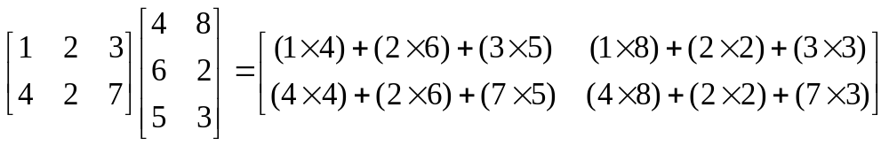
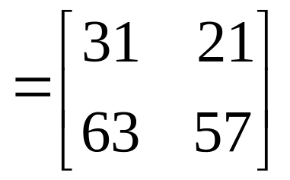
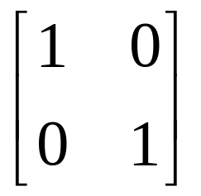
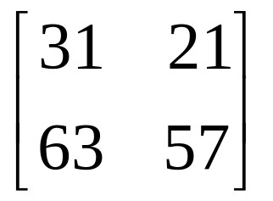
Matrices - Operations
Remember also:
IA = A

Slide 28
Matrices - Operations
Assuming that matrices A, B and C are conformable for the operations indicated, the following are true:
AI = IA = A
A(BC) = (AB)C = ABC - (associative law)
A(B+C) = AB + AC - (first distributive law)
(A+B)C = AC + BC - (second distributive law)
Caution!
AB not generally equal to BA, BA may not be conformable
If AB = 0, neither A nor B necessarily = 0
If AB = AC, B not necessarily = C

Slide 29
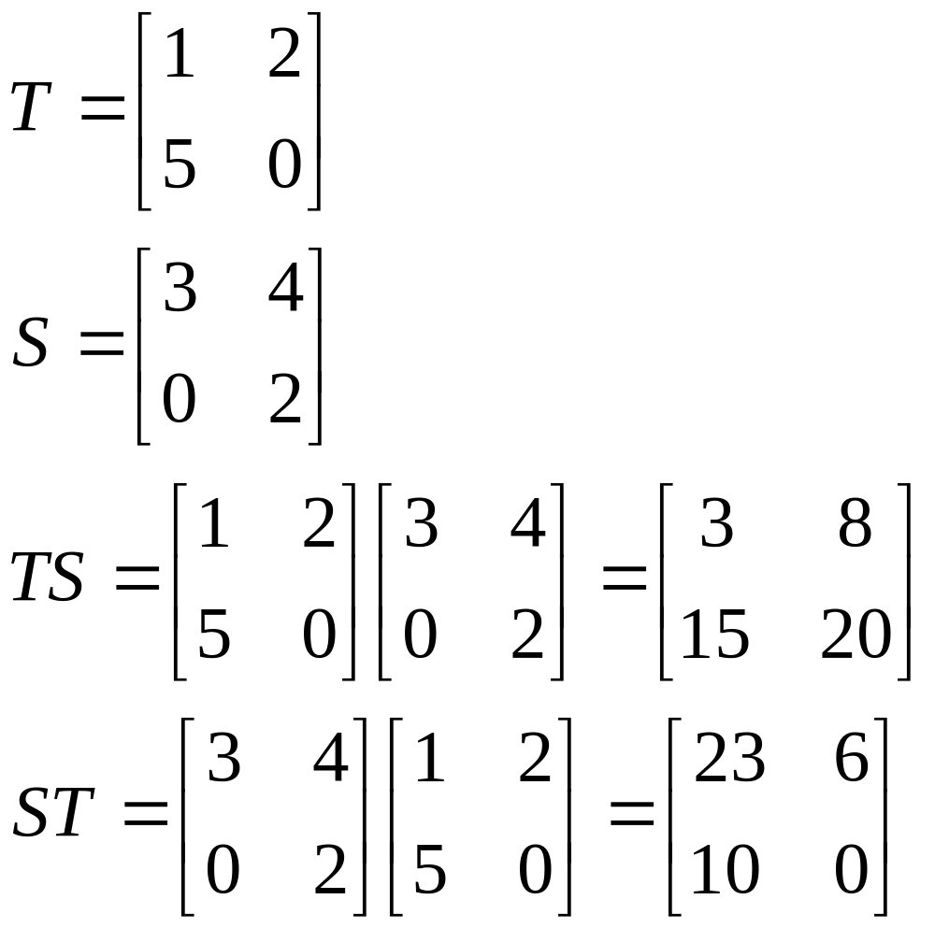
Matrices - Operations
AB not generally equal to BA, BA may not be conformable

Slide 30
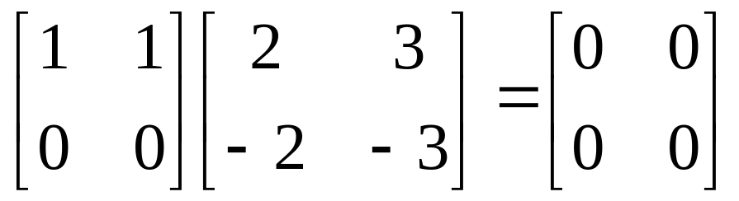
Matrices - Operations
If AB = 0, neither A nor B necessarily = 0

Slide 31
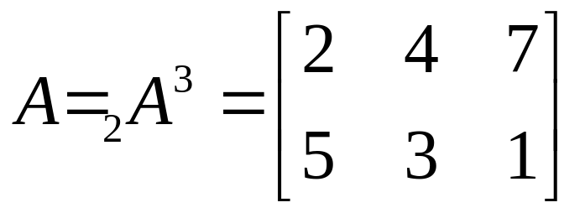
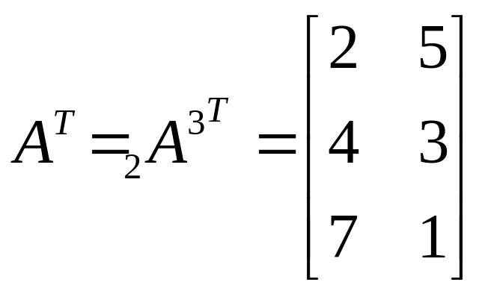
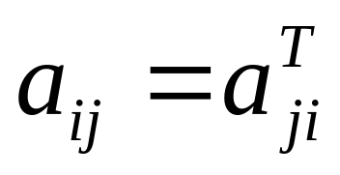
Matrices - Operations
TRANSPOSE OF A MATRIX
If :
2x3
Then transpose of A, denoted A^{T} is:
For all i and j

Slide 32
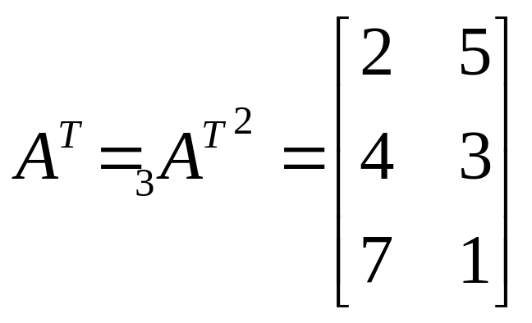
Matrices - Operations
To transpose:
Interchange rows and columns
The dimensions of A^{T} are the reverse of the dimensions of A
2 x 3
3 x 2

Slide 33
Matrices - Operations
Properties of transposed matrices:
(A+B)^{T} = A^{T} + B^{T}
(AB)^{T} = B^{T} A^{T}
(kA)^{T} = kA^{T}
(A^{T})^{T} = A

Slide 34


Matrices - Operations
(A+B)^{T} = A^{T} + B^{T}

Slide 35

Matrices - Operations
(AB)^{T} = B^{T} A^{T}

Slide 36

Matrices - Operations
SYMMETRIC MATRICES
A Square matrix is symmetric if it is equal to its transpose:
A = A^{T}

Slide 37

Matrices - Operations
When the original matrix is square, transposition does not affect the elements of the main diagonal
The identity matrix, I, a diagonal matrix D, and a scalar matrix, K, are equal to their transpose since the diagonal is unaffected.

Slide 38
Matrices - Operations
INVERSE OF A MATRIX
Consider a scalar k. The inverse is the reciprocal or division of 1 by the scalar.
Example:
k=7 the inverse of k or k⁻¹ = 1/k = 1/7
Division of matrices is not defined since there may be AB = AC while B = C
Instead matrix inversion is used.
The inverse of a square matrix, A, if it exists, is the unique matrix A⁻¹ where:
AA⁻¹ = A⁻¹ A = I

Slide 39


Matrices - Operations
Example:
Because:

Slide 40

Matrices - Operations
Properties of the inverse:
A square matrix that has an inverse is called a nonsingular matrix
A matrix that does not have an inverse is called a singular matrix
Square matrices have inverses except when the determinant is zero
When the determinant of a matrix is zero the matrix is singular

Slide 41

Matrices - Operations
DETERMINANT OF A MATRIX
To compute the inverse of a matrix, the determinant is required
Each square matrix A has a unit scalar value called the determinant of A, denoted by det A or |A|
If
then

Slide 42
Matrices - Operations
If A = [A] is a single element (1x1), then the determinant is defined as the value of the element
Then |A| =det A = a₁₁
If A is (n x n), its determinant may be defined in terms of order (n-1) or less.

Slide 43
Matrices - Operations
MINORS
If A is an n x n matrix and one row and one column are deleted, the resulting matrix is an (n-1) x (n-1) submatrix of A.
The determinant of such a submatrix is called a minor of A and is designated by m_{ij} , where i and j correspond to the deleted
row and column, respectively.
m_{ij} is the minor of the element a_{ij} in A.

Slide 44


Matrices - Operations
eg.
Each element in A has a minor
Delete first row and column from A .
The determinant of the remaining 2 x 2 submatrix is the minor of a₁₁

Slide 45


Matrices - Operations
Therefore the minor of a₁₂ is:
And the minor for a₁₃ is:

Slide 46


Matrices - Operations
COFACTORS
The cofactor C_{ij} of an element a_{ij} is defined as:
When the sum of a row number i and column j is even, c_{ij} = m_{ij} and when i+j is odd, c_{ij} =-m_{ij}

Slide 47

Matrices - Operations
DETERMINANTS CONTINUED
The determinant of an n x n matrix A can now be defined as
The determinant of A is therefore the sum of the products of the elements of the first row of A and their corresponding cofactors.
(It is possible to define |A| in terms of any other row or column but for simplicity, the first row only is used)

Slide 48




Matrices - Operations
Therefore the 2 x 2 matrix :
Has cofactors :
And:
And the determinant of A is:

Slide 49


Matrices - Operations
Example 1:

Slide 50


Matrices - Operations
For a 3 x 3 matrix:
The cofactors of the first row are:

Slide 51
Matrices - Operations
The determinant of a matrix A is:
Which by substituting for the cofactors in this case is:

Slide 52


Matrices - Operations
Example 2:

Slide 53


Matrices - Operations
ADJOINT MATRICES
A cofactor matrix C of a matrix A is the square matrix of the same order as A in which each element a_{ij} is replaced by its cofactor c_{ij} .
Example:
If
The cofactor C of A is

Slide 54


Matrices - Operations
The adjoint matrix of A, denoted by adj A, is the transpose of its cofactor matrix
It can be shown that:
A(adj A) = (adjA) A = |A| I
Example:

Slide 55


Matrices - Operations

Slide 56

Matrices - Operations
USING THE ADJOINT MATRIX IN MATRIX INVERSION
Since
AA⁻¹ = A⁻¹ A = I
and
A(adj A) = (adjA) A = |A| I
then

Slide 57



Matrices - Operations
Example
A =
To check
AA⁻¹ = A⁻¹ A = I

Slide 58




Matrices - Operations
Example 2
The determinant of A is
|A| = (3)(-1-0)-(-1)(-2-0)+(1)(4-1) = -2
The elements of the cofactor matrix are

Slide 59



Matrices - Operations
The cofactor matrix is therefore
so
and

Slide 60
Matrices - Operations
The result can be checked using
AA⁻¹ = A⁻¹ A = I
The determinant of a matrix must not be zero for the inverse to exist as there will not be a solution
Nonsingular matrices have non-zero determinants
Singular matrices have zero determinants

Slide 61
Matrix Inversion
Simple 2 x 2 case

Slide 62



Simple 2 x 2 case
Let
and
Since it is known that
A A⁻¹ = I
then

Slide 63


Simple 2 x 2 case
Multiplying gives
It can simply be shown that

Slide 64

Simple 2 x 2 case
thus

Slide 65

Simple 2 x 2 case

Slide 66

Simple 2 x 2 case

Slide 67

Simple 2 x 2 case

Slide 68


Simple 2 x 2 case
So that for a 2 x 2 matrix the inverse can be constructed in a simple fashion as
Exchange elements of main diagonal
Change sign in elements off main diagonal
Divide resulting matrix by the determinant

Slide 69


Simple 2 x 2 case
Example
Check inverse
A⁻¹ A=I

Slide 70
Matrices and Linear Equations
Linear Equations

Slide 71

Linear Equations
Linear equations are common and important for survey problems
Matrices can be used to express these linear equations and aid in the computation of unknown values
Example
n equations in n unknowns, the a_{ij} are numerical coefficients, the b_{i} are constants and the x_{j} are unknowns

Slide 72


Linear Equations
The equations may be expressed in the form
AX = B
where
and
n x n
n x 1
n x 1
Number of unknowns = number of equations = n

Slide 73
Linear Equations
If the determinant is nonzero, the equation can be solved to produce n numerical values for x that satisfy all the simultaneous equations
To solve, premultiply both sides of the equation by A⁻¹ which exists because |A| = 0
A⁻¹ AX = A⁻¹ B
Now since
A⁻¹ A = I
We get
X = A⁻¹ B
So if the inverse of the coefficient matrix is found, the unknowns, X would be determined

Slide 74


Linear Equations
Example
The equations can be expressed as

Slide 75


Linear Equations
When A⁻¹ is computed the equation becomes
Therefore

Slide 76

Linear Equations
The values for the unknowns should be checked by substitution back into the initial equations

